Slide 1
Main finding goes here, translated into plain English. Emphasize the important words.
Non-Cognitive Predictors of Student Success: A Predictive Validity Comparison Between Domestic and International Students
Title: Subtitle
AMMO BAR
Delete this and replace it with your…
Extra Graphs
Extra Correlation tables
Extra Figures
Extra nuance that you’re worried about leaving out.
Keep it messy! This section is just for you.
PRESENTER:
Leeroy Jenkins
BACKGROUND: Who cares? Explain why your study matters in the fastest, most brutal way possible (feel free to add graphics!). How this connects to Advanced manufacturing is a plus!
METHODS
Collected [what] from [population]
Tested it with X process.
Illustrate your methods if you can.
Try a flowchart!
RESULTS
Graph/table with essential results only.
All the other correlations in the ammo bar.
RESEARCH THRUST:
Ensure you place your KY NSF EPSCoR thrust here.
Visualize your findings with an image, graphic, or a key figure.
Leeroy Jenkins, author2, author3, author4, author5, author6, author7, author42
Add a link here to download the full paper, or use a QR code if printed
This material is based upon work supported by the
National Science Foundation under Cooperative
Agreement No. 1849213.
Notes:
Notes:
In Powerpoint, click View > Guides
Keep text within gutter guides.
Author list: Don’t split names onto two lines (e.g., “Jimmy [break] Smith”). If that happens, use a new line, unless you need the space. Bold the first names of anybody who’s presenting in person.
Intro/methods/result: Do not drop below font size 28, but if you have extra space, jack up the font size until the space is full.
Do not use color in the sidebars except in graphs/figures. It’ll pull attention from the center and slow interpretation for passersby.

Slide 2
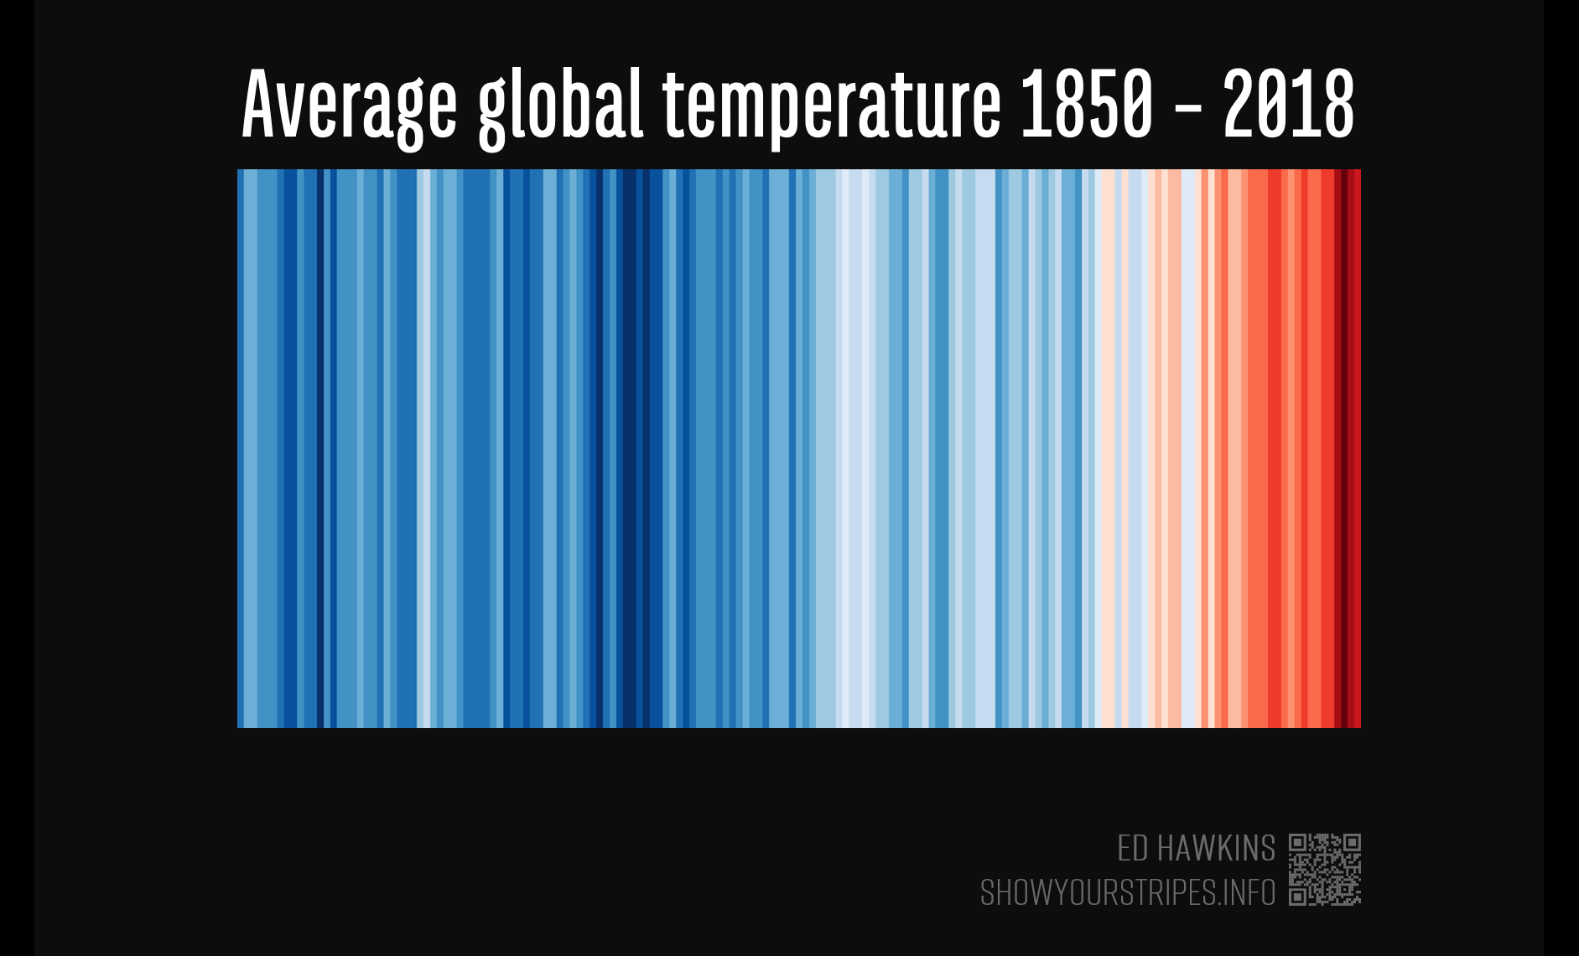
The #betterposter collection…
Original
Presenter
Figure Hero
Data Art

Slide 3
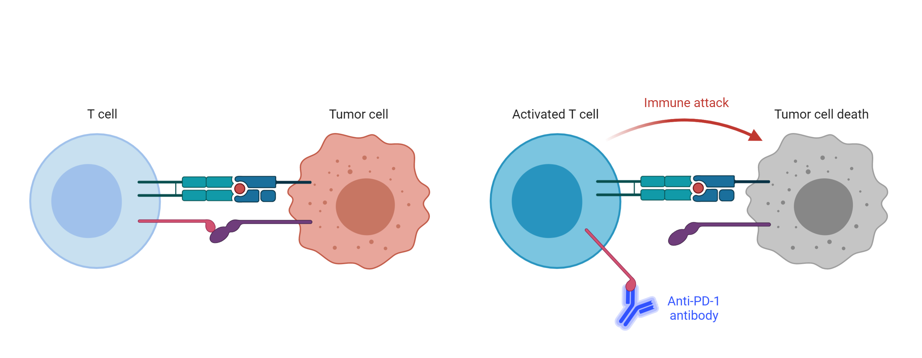
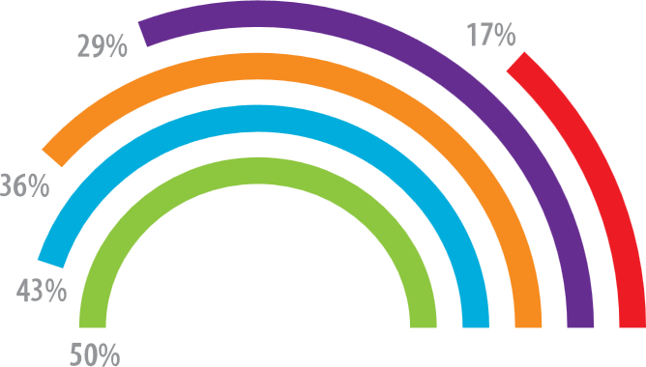
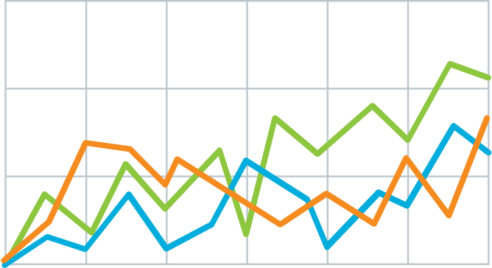
Teach people something cool you learned in 5 seconds as they walk by (or scroll by).
Method
v
Immune checkpoint inhibits T-cell activation.
Anti-PDF-1 antibodies permit T cell activation.
Explain what the graph shows. Like, spoilers are good.
Quickly explain what the graph shows. Help people think.
v
v
(illustrate your takeaway point)
LEM HEWITT, Phillip Merman, Ted crisp EXAMPLE Graphics donated by biorender.com
PrePrint

Slide 4
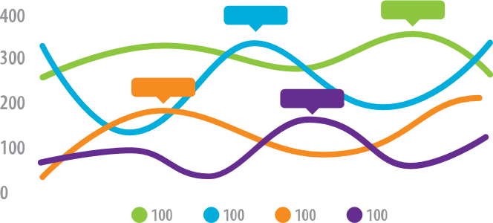
PRESENTER
Lem Hewitt
Teach people something cool you learned in 5 seconds as they walk by.
Background
Who cares? Explain why your study matters in the fastest, most brutal way possible (feel free to add graphics!).
Methods
N=564 Adult full-time workers
EXPERIMENT GROUP
Given iPod Touch’s with a special app that pings them throughout the day with quick surveys.
Wait list (CONTROL GROUP)
Mood Survey (4x per day)
Participants notified by the iPod at random times to take a short mood survey assessing current mood and attention.
End-of-week Survey
Assessed overall performance for the week.
HLM analysis
Used to relate within-person mood to differences in performance.
Extra results
Assume they already read your punchline, and now include a little extra detail.
PrePrint
LEM HEWITT, Phillip Merman, Ted crisp, veronica palmer

Slide 5
Add a key figure Show-and-tell the best, most insightful part of your methods & data.
Example donated by @drElsje

Slide 6
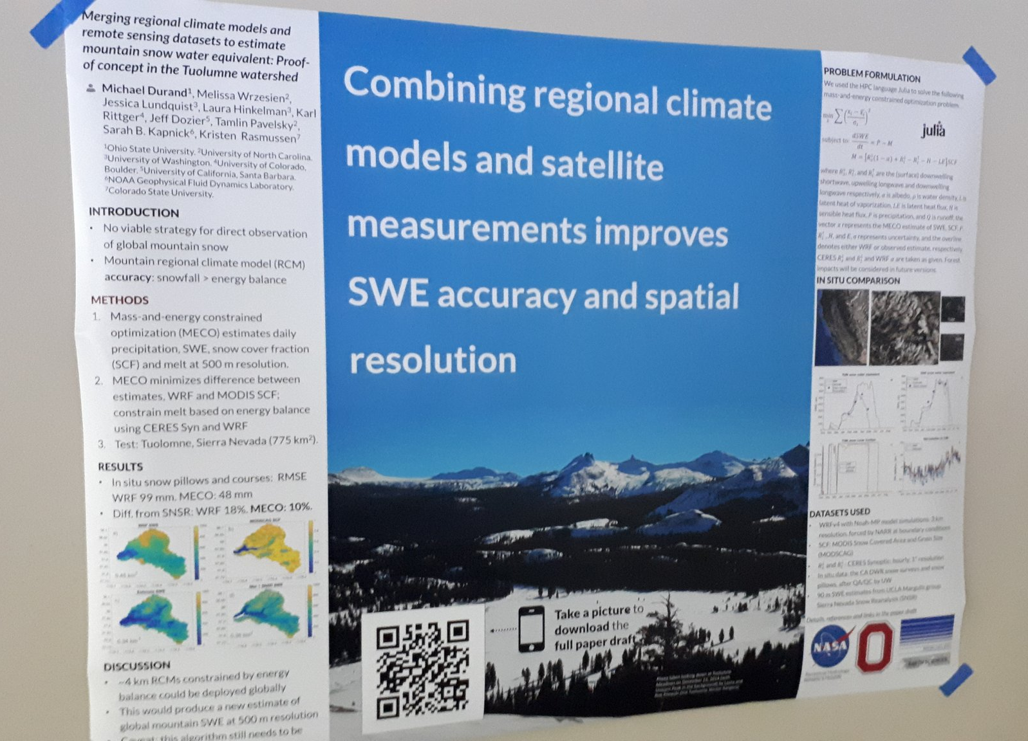
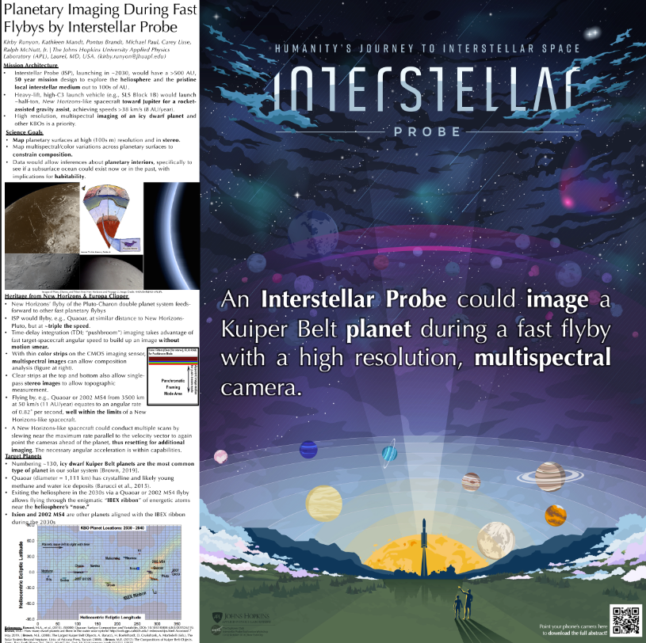
Try an on-theme background. Add fun and reinforce your study’s context, but make sure to keep a high contrast between your text and background!
Example donated by @brenden0walker
Example donated by @hydrogawker
Mountain photo by @mnthydro
Example donated by @nasaman58
vvv
Example donated by @SarraceniaMason
Example donated by @americoamorim
Example by @mikemorrison

Slide 7
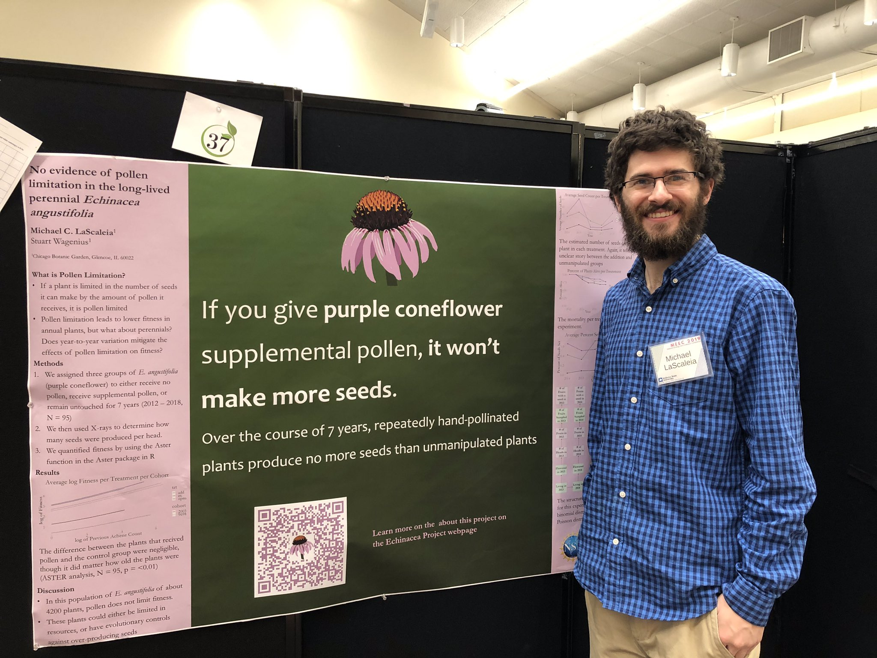
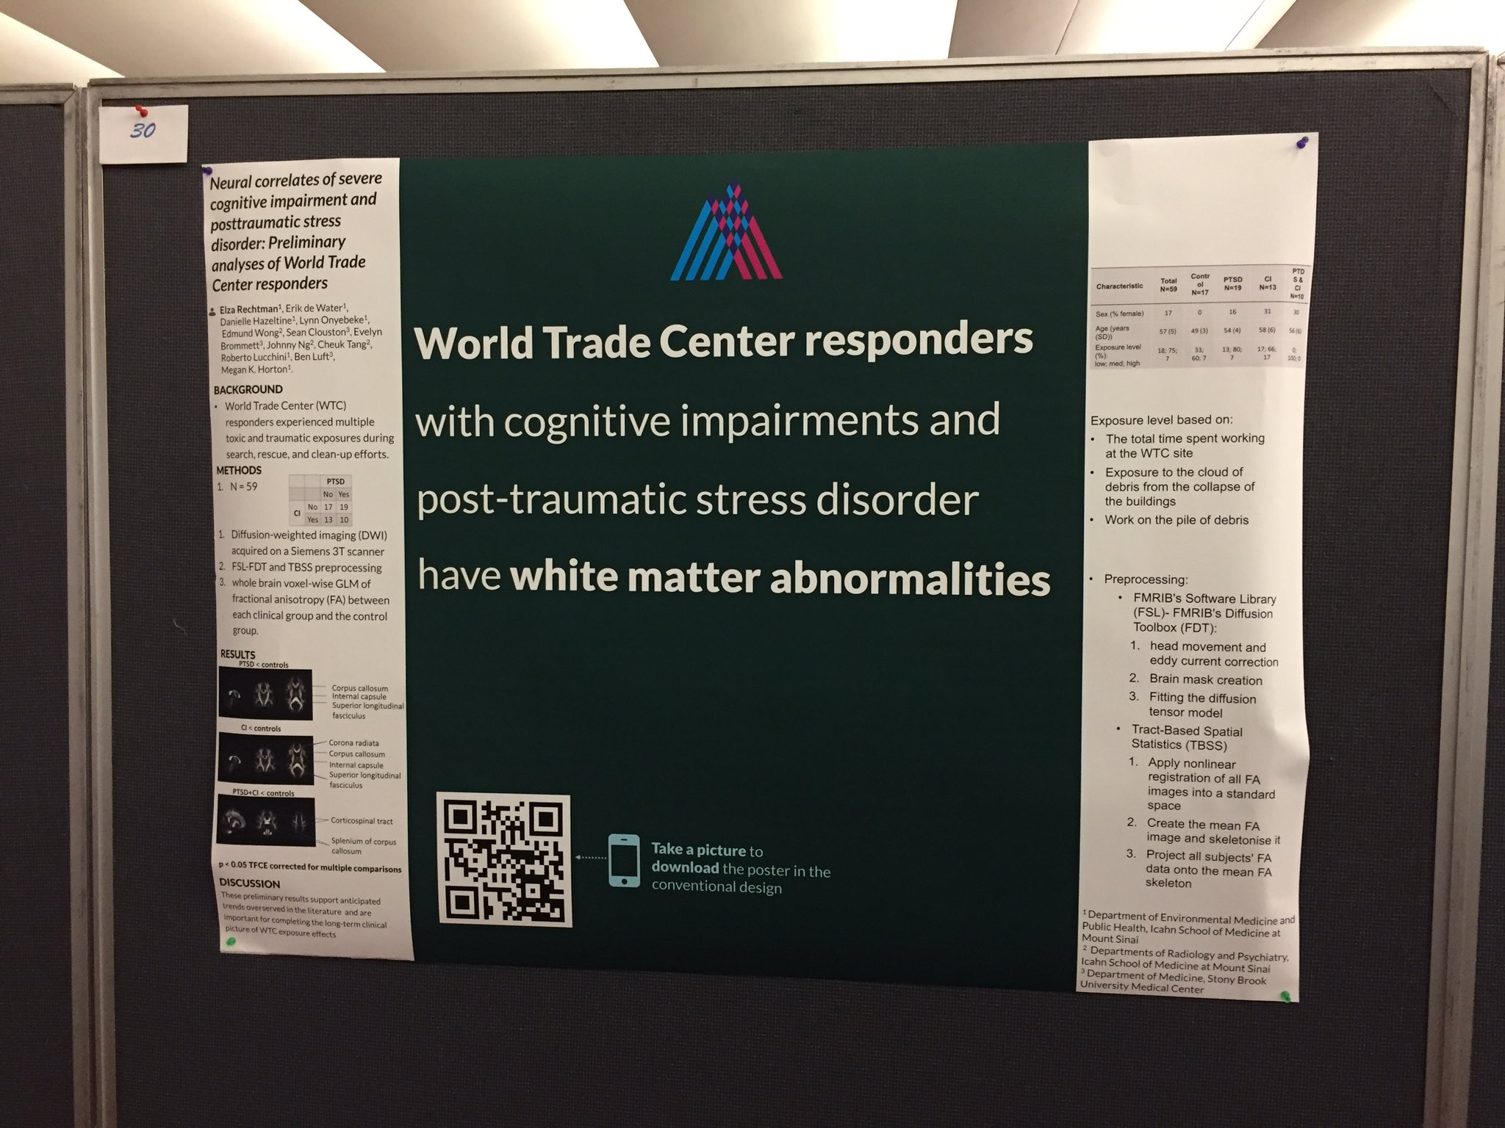
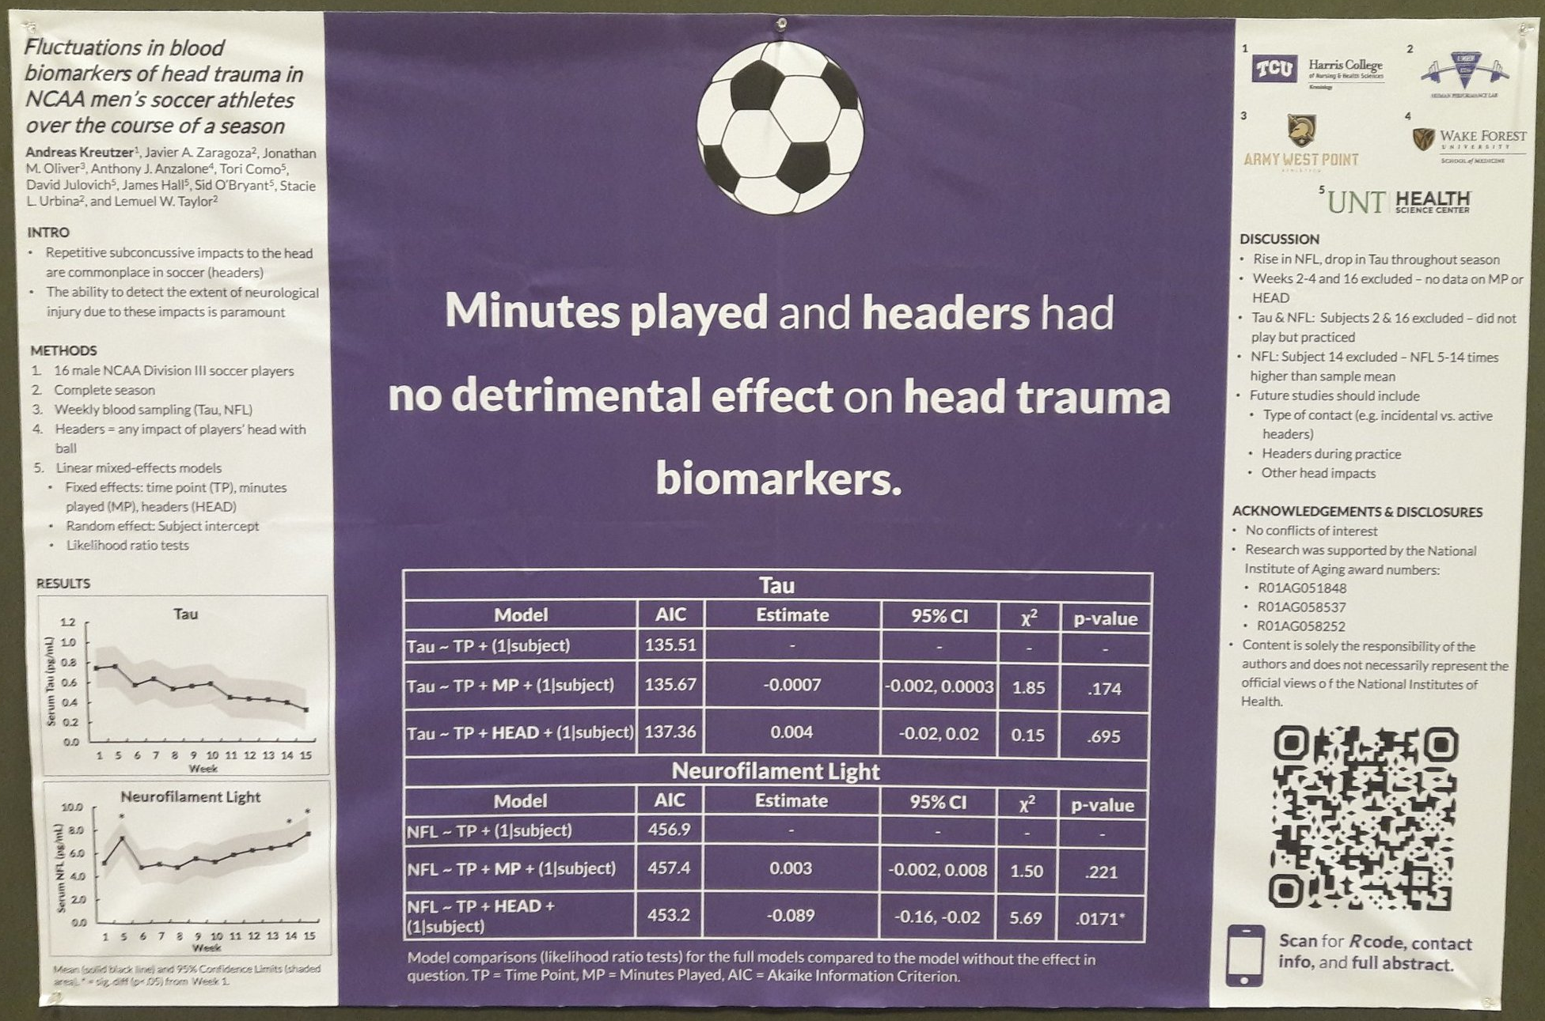
Try a ‘hat’ icon. Fun, reinforces your finding, makes your poster memorable — and can be interpreted at-a-glance.
Example donated by @MCLaScience
Example donated by @DStroumsa
Example donated by @ElzaRechtman
Example donated by @mikemorrison
Example donated by @akreutzer82

Slide 8
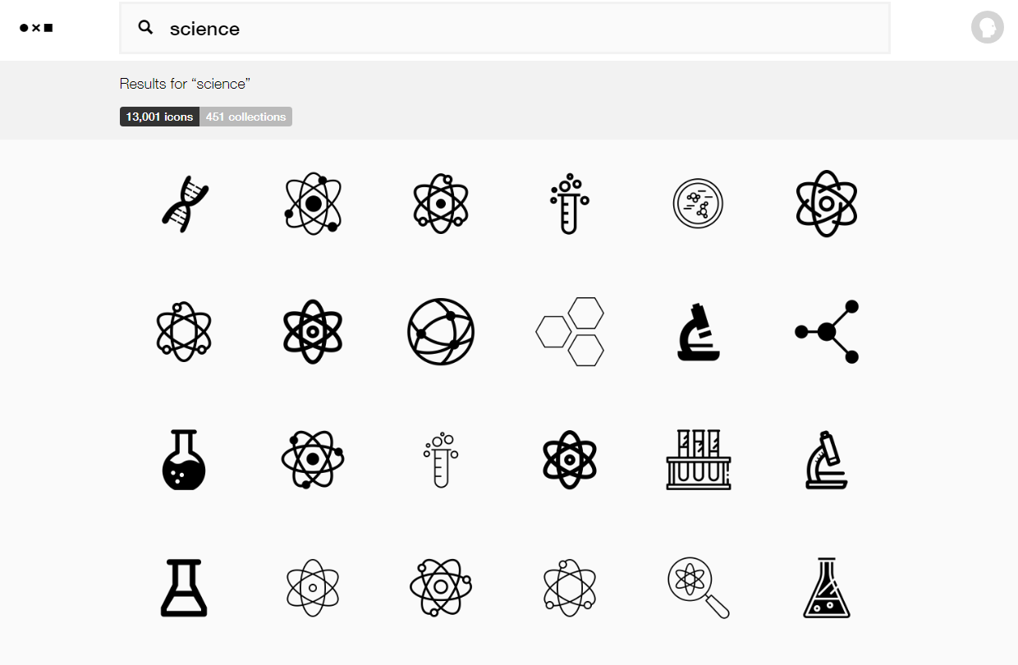
You can get free icons from TheNounProject.com
https://thenounproject.com

Slide 9
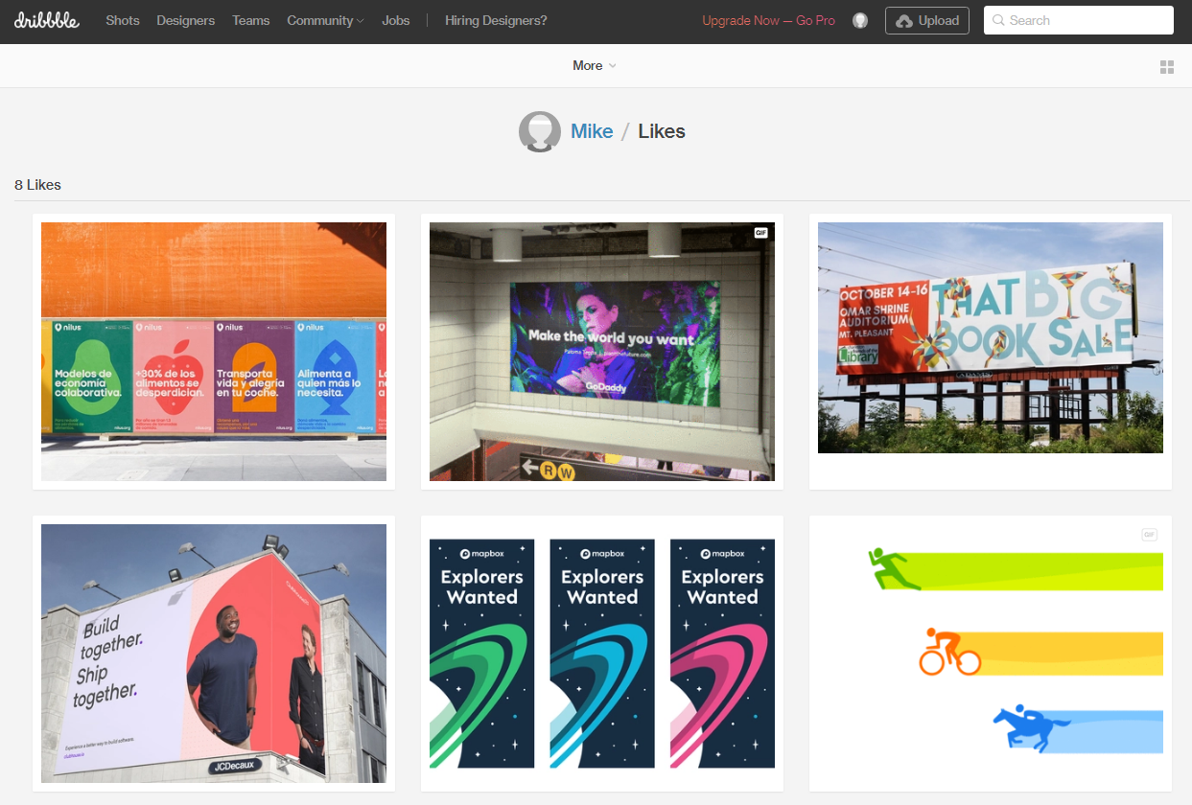
Stuck on a design dilemma? Do what other designers do! Go to dribbble.com and scroll through stuff until a solution jumps out at you. Try searching for “posters” or “graph”.
https://dribbble.com/

Slide 10
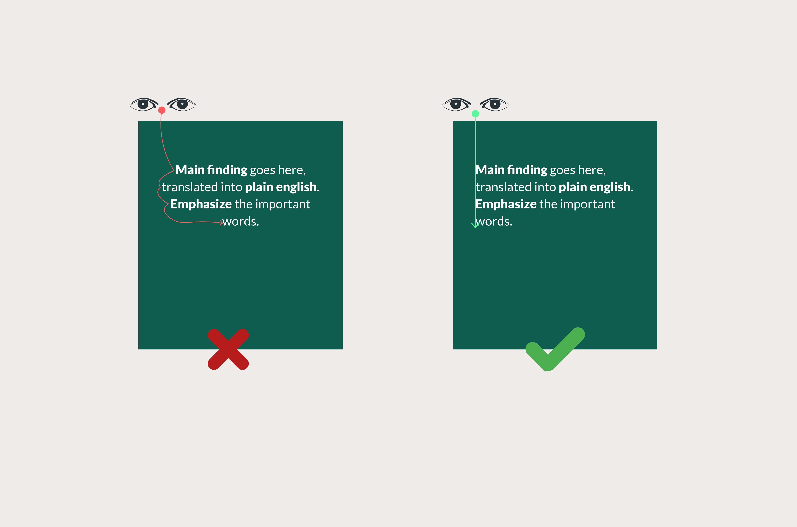
If your punchline is more than 2 lines, don’t center it. Centered text is slower to read than left-aligned text.

Slide 11
Example by @mikemorrison

Slide 12
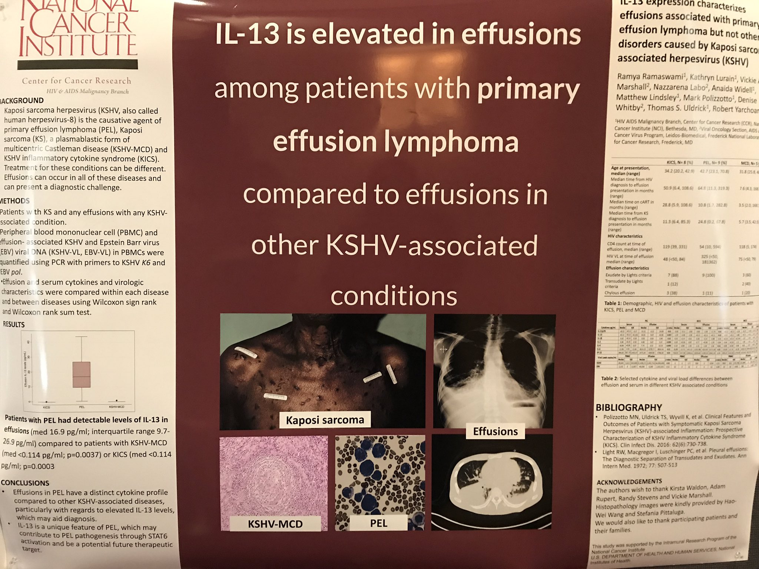
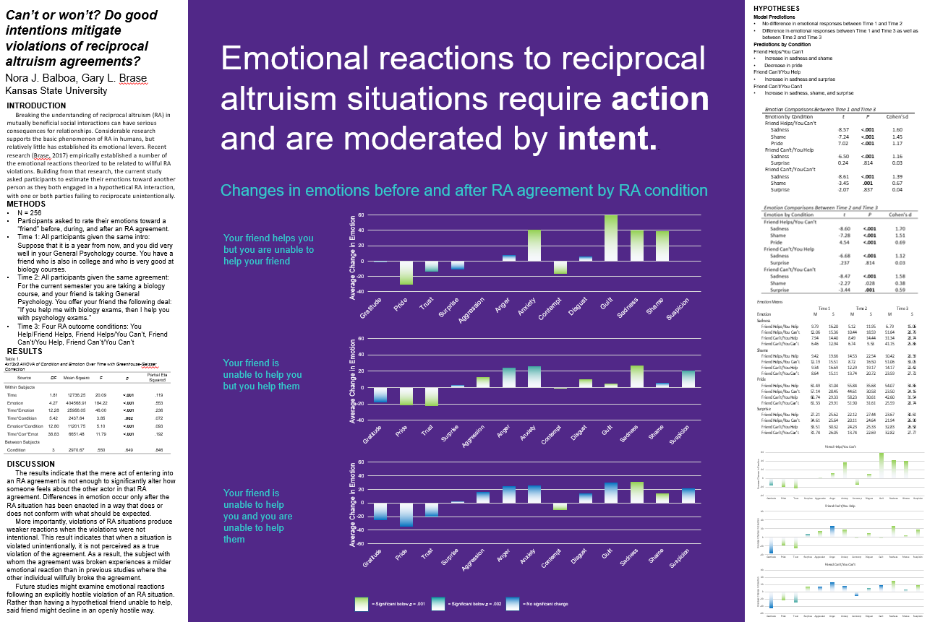
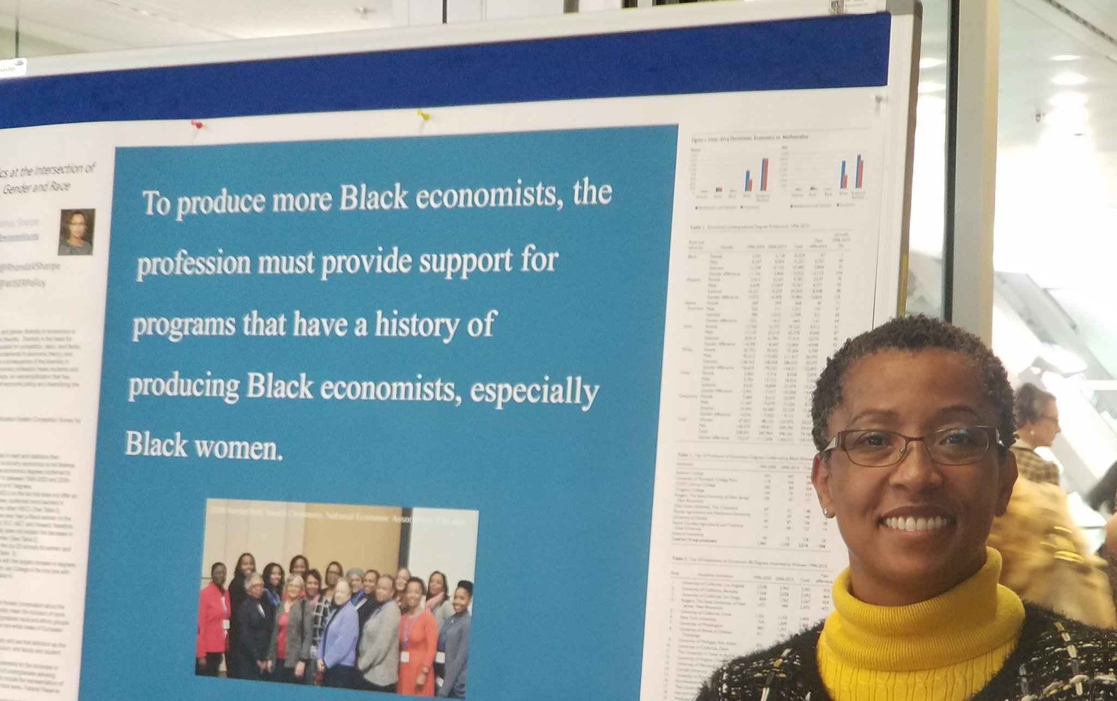
Example donated by @MattKuhnDVM
Example donated by @SPrinceWare
Example donated by @ramya_ramaswami
Example donated by @NoraBalboa
Example donated by @BrzezinskiRafi
Example donated by @RhondaVSharpe

Slide 13
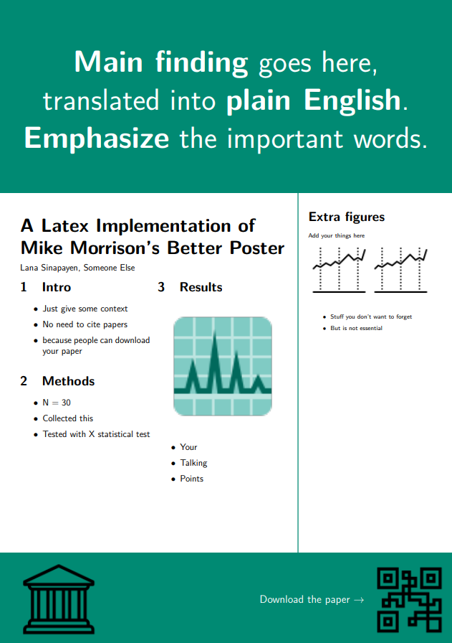
Templates
Portrait
Landscape
by @sina_lana
by @rtsbailo
Download (Ctrl/Cmd + Click)
Download (Ctrl/Cmd + Click)
https://github.com/LanaSina/better_poster_latex
https://www.overleaf.com/latex/templates/better-poster-latex-template/gmkgjvxqbyyt

Slide 14
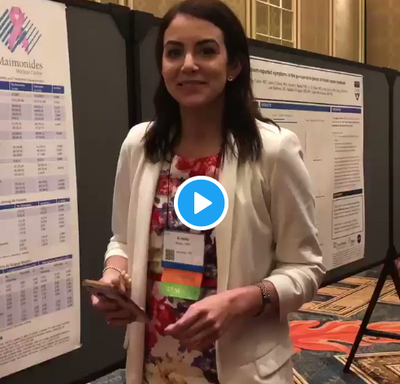
How to QR Code
How do I create a QR code?
https://www.qrcode-monkey.com/ is free, URLs don’t expire, and you can add cool features like images.
How do I scan a QR code?
Just pull out your phone and take a picture! All modern iPhones and most Android phones have built-in QR detection in their cameras. Some Android phones may need an app.
How can I link the QR to my paper and a copy of my poster and my contact details.
Try creating a multi-page link for free via https://linktr.ee/. (Still trying to figure out the best answer to this though.
Ctrl-click this thumbnail to watch a video on scanning #betterposter QR codes.
Donated by @kristinrojasmd
https://twitter.com/kristinrojasmd/status/1124418213050298368

